Slide 1

Java Programming Essentials: A Comprehensive Journey into Core Java and Beyond
Bharath Ashok

Slide 2

Day 18

Slide 3
Day 17 and Day 18: Agenda
Lambda Expression
Functional Interfaces
Static and Default Methods
Method References
Stream API
Optional Class
Time API
Hands-on
Assignments
Interview Questions

Slide 4
Java 8

Slide 5
Features of Java 8
Lambda Expressions
Functional Interfaces
Default and Static Methods in Interfaces
Method References
Streams
New Date and Time API
Optional

Slide 6
Lambda Expressions

Slide 7
Lambda Expressions
A lambda expression in Java is a way to represent an anonymous function, also known as a lambda function or lambda.
It allows to define a block of code that can be passed around as a value and executed later.
Lambda expressions were introduced in Java 8 and are a fundamental feature of functional programming in Java.
EX:
(parameters) -> expression
(x, y) -> x + y
(str) -> str.length()
() -> "Hello, Lambda!“
Usage:
Runnable runnable = () -> {
System.out.println("Executing a lambda function!");
};

Slide 8
Functional Interfaces

Slide 9
Functional Interfaces
A functional interface is an interface that has exactly one abstract method (SAM), but it can also have multiple default and static methods.
Functional interfaces serve as the basis for working with lambda expressions and method references, enabling a more functional programming style in Java.
Key Characteristics:
Single Abstract Method (SAM)
Multiple Default and Static Methods
Examples of Functional Interfaces:
Consumer<T>: Represents an operation that accepts a single argument and returns no result.
Supplier<T>: Represents a supplier of results.
Predicate<T>: Represents a function that takes an argument of type T and returns a boolean.
Function<T, R>: Represents a function that takes an argument of type T and returns a result of type R.

Slide 10
Custom Functional Interfaces
Creating Custom Functional Interfaces:
@FunctionalInterface
interface MyFunctionalInterface {
int performOperation(int a, int b);
}
Creating Runnable with Lambda:
Runnable myRunnable = () -> System.out.println("Running!");

Slide 11
Hands-On

Slide 12
Default and Static Methods in Interfaces
Default and Static Methods in Interfaces

Slide 13
Default Methods
Default and static methods in interfaces were introduced in Java 8 to provide a way to add new functionality to existing interfaces without breaking the implementing classes.
A default method is a method defined in an interface with a default implementation.
It provides a default behavior that can be overridden by classes implementing the interface.
The primary purpose of default methods is to maintain backward compatibility with existing code while adding new functionality.
public interface MyInterface {
// Regular abstract method
void regularMethod();
// Default method with a default implementation
default void defaultMethod() {
// Default implementation
}
}

Slide 14
Static Methods
A static method in an interface is a method that is associated with the interface itself rather than with the instances of the implementing classes.
It is not inherited by the implementing classes and can only be called using the interface name.
EX:
public interface MyInterface {
// Static method
static void staticMethod() {
// Implementation
}
}

Slide 15
Hands-On

Slide 16
Method References

Slide 17
Method References
Method references in Java provide a concise way to refer to methods or constructors in a more compact and readable form.
They are often used in functional programming and lambda expressions, allowing you to treat methods as first-class objects
Method references simplify the code when you need to pass a method as an argument to another method.
There are four main types of method references in Java:
Reference to a Static Method
Reference to an Instance Method of a Particular Object
Reference to an Instance Method of an Arbitrary Object of a Particular Type
Reference to a Constructor

Slide 18
Reference to a Static Method
Sample Code:
// Lambda expression to find the length of a string
Function<String, Integer> lambda = str -> str.length();
// Method reference to String's length() static method
Function<String, Integer> methodReference = String::length;
int length1 = lambda.apply("Hello, Lambda!"); // Using lambda expression
int length2 = methodReference.apply("Hello, Method Reference!"); // Using method reference

Slide 19
Hands-On

Slide 20
Reference to an Instance Method of a Particular Object
Sample Code:
class MyClass {
public void print(String str) {
System.out.println(str);
}
}
MyClass myObj = new MyClass();
// Lambda expression to call print() on myObj
Consumer<String> lambda = str -> myObj.print(str);
// Method reference to call print() on myObj
Consumer<String> methodReference = myObj::print;
lambda.accept("Hello, Lambda!"); // Using lambda expression
methodReference.accept("Hello, Method Reference!"); // Using method reference

Slide 21
Hands-On

Slide 22
Reference to a Constructor
Sample Code:
class Person {
private String name;
public Person(String name) {
this.name = name;
}
public String getName() {
return name;
}
}
// Lambda expression to create Person objects
Supplier<Person> lambda = () -> new Person("Alice");
// Method reference to create Person objects using the constructor
Supplier<Person> methodReference = Person::new;
Person person1 = lambda.get(); // Using lambda expression
Person person2 = methodReference.get(); // Using method reference

Slide 23
Hands-On

Slide 24
Stream API

Slide 25
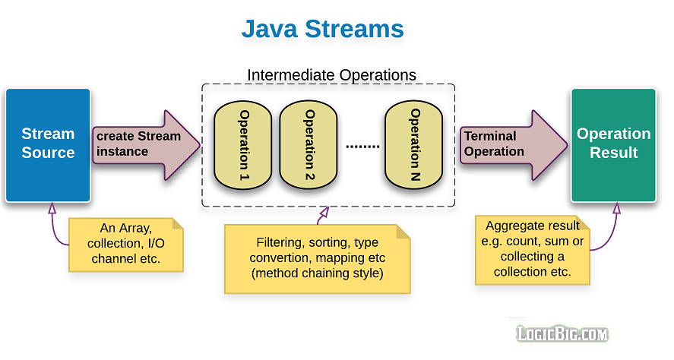
Stream API
The Stream API in Java is a powerful feature introduced in Java 8 that allows you to process sequences of data in a functional and declarative way.
It provides a higher-level abstraction for working with collections (e.g., lists, sets, and maps) and arrays.
Enables to perform various operations on the data, such as filtering, mapping and more, in a concise and expressive manner.
Key characteristics of the Stream API:
Stream:
Functional Operations
Lazy Evaluation

Slide 26
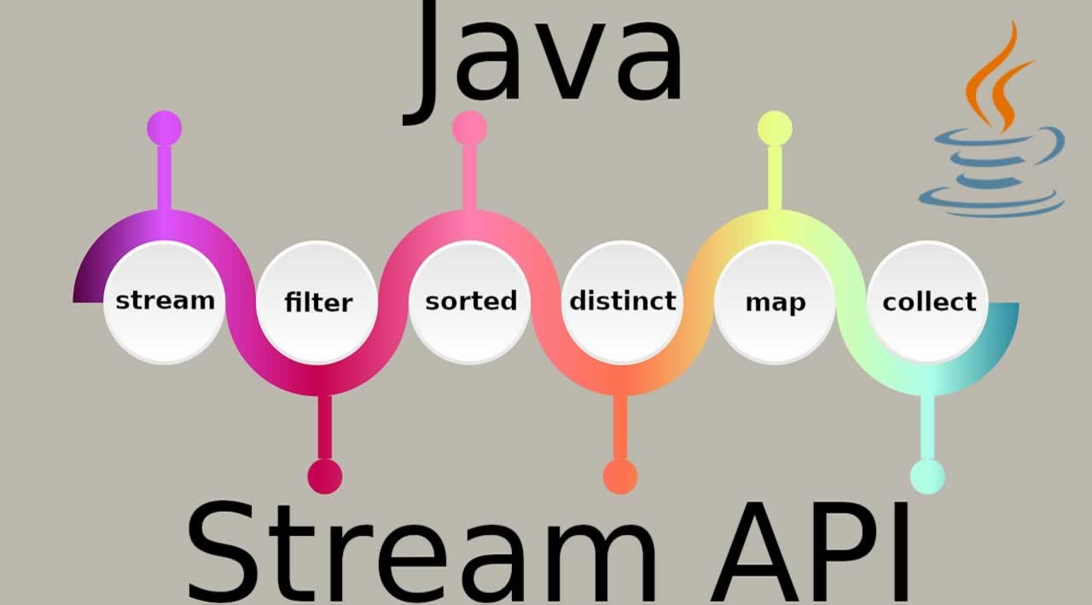
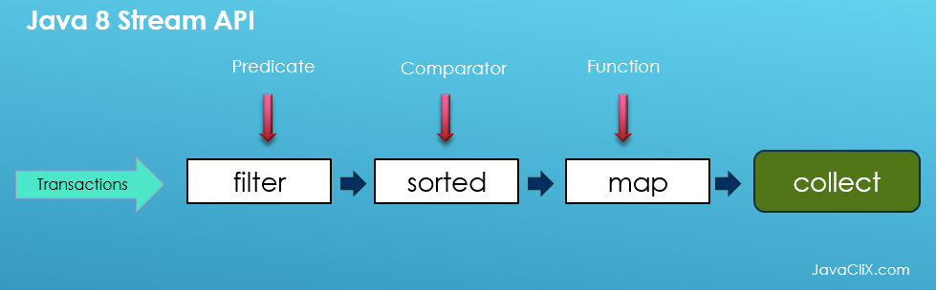
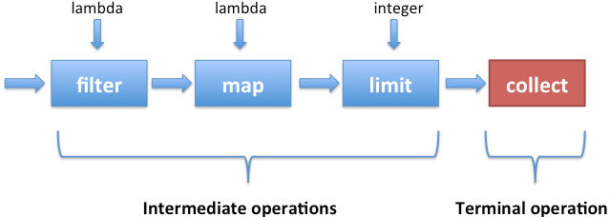
Key characteristics of the Stream API
Stream: A stream is a sequence of elements that can be processed in a pipelined fashion. Streams do not store data; they provide a way to access and manipulate data from a source (e.g., a collection, an array, or I/O channel)
Functional Operations: Streams support functional-style operations, which can be combined to create complex data processing pipelines.
Intermediate Operations: Common intermediate operations include filter, map, flatMap, distinct, sorted and more.
These operations are lazy.
Meaning they are only executed when a terminal operation is invoked
Terminal Operations:
Common terminal operations include forEach, collect, min, max, count, and toArray.

Slide 27
Hands-On

Slide 28
Optional Class

Slide 29
Java.util.Optional
The Optional class is a container object that may or may not contain a non-null value.
The Optional class encourages a safer approach to dealing with potential null values by providing a set of methods to work with these values.
Key Features:
Avoiding NullPointerExceptions
Container of values

Slide 30
Hands-On

Slide 31
Time API

Slide 32
Time API
The Java Time API, provides a comprehensive set of classes for handling date and time in a more flexible, precise, and human-readable manner compared to the older java.util.Date and java.util.Calendar classes.
The key classes in the Java Time API are part of the java.time package

Slide 33
Hands-On

Slide 34
Interview Questions

Slide 35
Hands-On

Slide 36
Java 8 Interview Questions

Slide 37
Java8 Interview Questions
What are the key features introduced in Java 8?
What is a lambda expression in Java 8, and how is it used?
Explain the concept of the Stream API in Java 8.
How does Java 8 support functional programming? Provide examples.
What is the difference between functional interfaces and regular interfaces in Java 8?
How can you create a custom functional interface in Java 8?
What is the purpose of the java.util.function package in Java 8?
What are method references in Java 8, and how do they work?
Explain the default and static methods in interfaces introduced in Java 8.
What is the java.time package in Java 8, and how does it improve date and time handling?

Slide 38
Java8 Interview Questions
What is the difference between the "map" and "flatMap" operations in Java 8 Streams?
How does the "filter" operation work in Java 8 Streams, and how is it used?
Explain the concept of the "reduce" operation in Java 8 Streams. Provide an example.
What is the purpose of the "groupingBy" collector in Java 8 Streams?
How do you create a custom collector in Java 8?
Describe the "peek" operation in Java 8 Streams and its use cases.
What is the "parallelStream" method, and how does it enable parallel processing in Java 8?
How can you sort a list of objects using the new "Comparator" methods introduced in Java 8?
Explain the concept of default methods in interfaces and how they impact existing code.

Slide 39
Java8 Interview Questions
How do you use the Optional class in Java 8 to handle potentially null values?
Describe the forEach() method in Java 8, and how is it used with collections?
What is the purpose of the Collector interface and the Collectors class in Java 8?
What is the role of the new @FunctionalInterface annotation in Java 8?
How do you perform parallel processing with Streams in Java 8?
How does the "try-with-resources" statement in Java 8 simplify resource management?
What is the purpose of the "CompletableFuture" class in asynchronous programming in Java 8?
What is the purpose of the sorted method in Streams?
How can you use the distinct method to remove duplicate elements from a Stream?

Slide 40
Java8 Interview Questions
What is the purpose of the sorted method in Streams?
How can you use the distinct method to remove duplicate elements from a Stream?
What are method references in Java 8, and how do they simplify code?
Can you use lambda expressions with non-functional interfaces?
Explain how the map operation works in Streams and provide an example.
How does the reduce operation work in Streams, and what is it used for?
How do you use the forEach method with Streams, and what is its purpose?
What is the purpose of the :: operator in method references?

Slide 41
Java8 Assignments

Slide 42
Java8 Assignments
Assignment 1: Lambda Expressions
Write a Java program that uses lambda expressions to filter a list of integers. The program should take a list of integers as input and filter out even numbers. Then, it should print the filtered list.
Assignment 2: Stream API
Create a Java program that reads a text file containing a list of names. Use the Stream API to process the names and remove duplicate names, sort the names alphabetically , filter out names that start with a specific letter (user input) and finally print the final list of names
Assignment 3: Method References
Implement a program that uses method references to perform mathematical operations on a list of numbers. The program should allow the user to choose between addition, subtraction, multiplication, or division operations and then apply the selected operation to the list of numbers using method references.

Slide 43
Java8 Assignments
Assignment 4: CompletableFuture
Create a program that simulates a simple online order processing system. Use CompletableFuture to represent the processing of different order tasks asynchronously. Display a message when all tasks are completed.
Assignment 5: Optional Handling
Write a program that reads a user's age from input and calculates the year of birth. Use Optional to handle cases where the user enters an invalid age (e.g., a negative number). Display the calculated year of birth or an error message.
Assignment 6: Date and Time Handling
Create a scheduling application that allows users to add, view, and manage appointments. Use the java.time package to represent dates and times accurately. Ensure that the application prevents scheduling conflicts and sends reminders for upcoming appointments.

Slide 44
Q&A

Slide 45
Java Interview Questions

